Slide 1
MBA 652A Statistical Modelling for Business Analytics
Project III– Telecom Customer Churn Prediction
Submitted By:
Abhishek Sahu (20114002)
Pushkar Awasthi (21114014)
Saurabh Sachan (20114018)
Sumit Tripathi (20114022)
Submitted To:
Prof. Devlina Chatterjee
IME, IIT KANPUR

Slide 2
Contents
Introduction
Problem statement
Methodology
Data Description and Source
Data Analysis
Data Preparation
Building Models
Confusion matrix & ROC curve of final model
Prediction on Test Dataset
Conclusion

Slide 3
01-INTRODUCTION
Customer attrition, also known as customer churn is the loss of clients or customers .Telephone service companies, Internet service providers often use customer attrition analysis and customer attrition rates as one of their key business metrics because the cost of retaining an existing customer is far less than acquiring a new one.
Companies usually make a distinction between voluntary churn and involuntary churn. Voluntary churn occurs due to a decision by the customer to switch to another company or service provider, involuntary churn occurs due to circumstances such as a customer's relocation to a long-term care facility, death, or the relocation to a distant location. In most applications involuntary reasons for churn are excluded from the analytical models.

Slide 4
01-PROBLEM STATEMENT
The objective of the project is to predict whether a customer will churn or not using Logistic Regression Technique and to formulate models depicting the effects of various factors. We will try to evaluate all the possible combination of variables that explains the reason of churning and try to conclude the best possible combination.
The target variable here is ‘Churn’ which will tell us whether or not a particular customer has churned. It is a binary variable 1 means that the customer has churned and 0 means the customer has not churned .With 21 predictor variables we need to predict whether a particular customer will switch to another telecom provider or not.
The dataset contains 21 features including the churn, along with 7042 observations.

Slide 5
02- METHODOLOGY
Summary of data and data visualization.
Start building model using logit regression and probit regression.
Then on the basis of threshold p-values and VIF(Variance Inflation Factor) we have done backward elimination and have eliminated insignificant variables

Slide 6
03- DATA DESCRIPTION
Source of Data :- Kaggle
Dataset :-https://www.kaggle.com/blastchar/telco-customer-churn
Dependent Variable :- Churn : Whether the customer churned or not (Yes or No).
Independent Variables :- There are 20 independent variables.

Slide 7
customer ID : Customer ID
Gender : Customer gender (female, male)
Senior Citizen : Whether the customer is a senior citizen or not (1, 0)
Partner : Whether the customer has a partner or not (Yes, No)
Dependents : Whether the customer has dependents or not (Yes, No)
tenure : Number of months the customer has stayed with the company
Phone Service : Whether the customer has a phone service or not (Yes, No)
Multiple Lines : Whether the customer has multiple lines or not (Yes, No, No phone service)
Internet Service : Customer’s internet service provider (DSL, Fiber optic, No)

Slide 8
Online Backup : Whether the customer has online backup or not (Yes, No, No internet service)
Online Security : Whether the customer has online security or not (Yes, No, No internet service)
Device Protection : Whether the customer has device protection or not (Yes, No, No internet service)
Tech Support : Whether the customer has tech support or not (Yes, No, No internet service)
Streaming TV : Whether the customer has streaming TV or not (Yes, No, No internet service)
Streaming Movies : Whether the customer has streaming movies or not (Yes, No, No internet service)
Contract : The contract term of the customer (Month-to-month, One year, Two year)
Paperless Billing : Whether the customer has paperless billing or not (Yes, No)
Payment Method : The customer’s payment method (Electronic check, Mailed check, Bank transfer (automatic), Credit card (automatic))
Monthly Charges :The amount charged to the customer monthly
Total Charges : The total amount charged to the customer

Slide 9
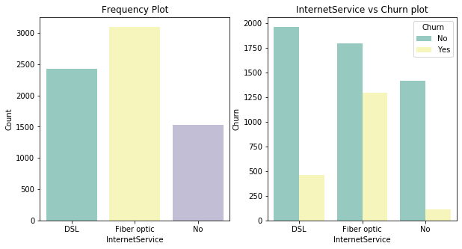
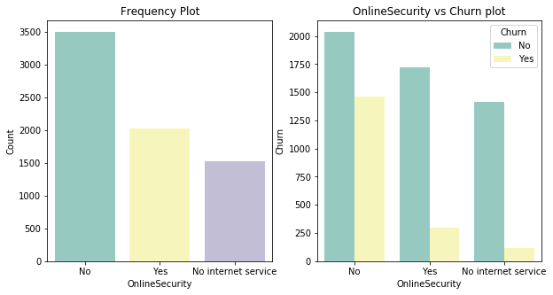
Data Analysis:
Univariate analysis to understand the churn:
Observation: Churn rate for Fiber optic customers are more when compared to DSL and No service provider
Churn rate is higher for the subscribers who doesn't have online security.

Slide 10
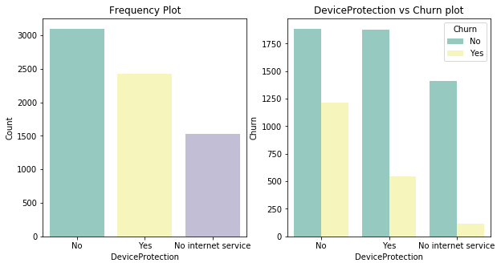

Churn rate is high for subscribers having no device protection
Churn rate is higher for the subscribers who are not subscribed to Tech support

Slide 11
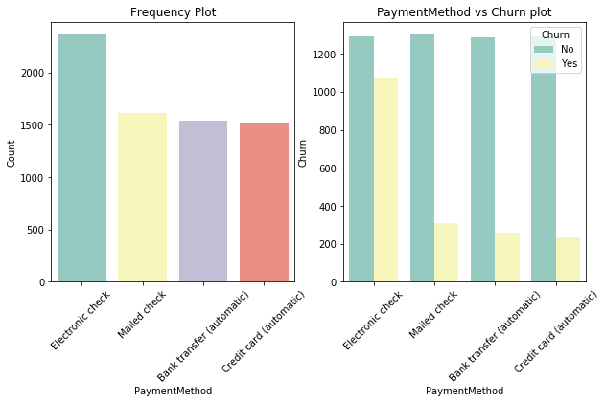
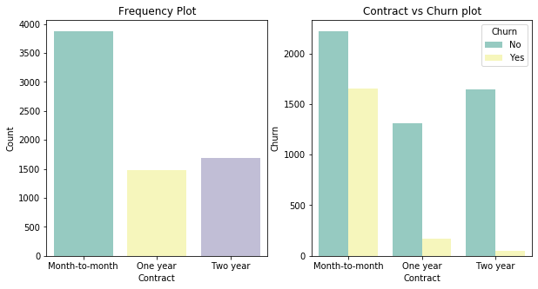
Churn rate is higher for the subscribers having month to month contract.
Most of the Churn cases are the subscribers who do the payment method by Electronic check.

Slide 12
OBSERVATIONS:
We cannot see a real Impact of gender
Seniors have less loyalty
Partners are more loyal
Dependents are more loyal
Customers does not have multiplelines are more loyal
Customer are not happy with Optical Fiber and Leaving with rate of other internet services
Customers with month-to-month contract are more willing to leave
Paperless customers are more willing to leave than paper billing
Customer pay using electronic check is more willing to leave

Slide 13
DATA PREPARATION:
'Phone Service', 'Paperless Billing', 'Churn', 'Partner', 'Dependents‘ – these variables are mapped into 0 and 1 for No and Yes respectively.
Next we create dummies for the other categorical variables and add the results to the master dataframe
Then we drop the original columns
Next we splitted our entire dataset into test and train as 30% and 70% respectively
Finally we apply feature scaling for 'Monthly Charges', 'tenure', 'Total Charges‘ attributes
From the co-relation matrix, we found out that Mutliple lines_No,Onlinesecurity_No, Device protection_No, Streaming tv_No, Techsupport_No, Streaming movies_No variables are highly correalated . So we removed them.

Slide 14
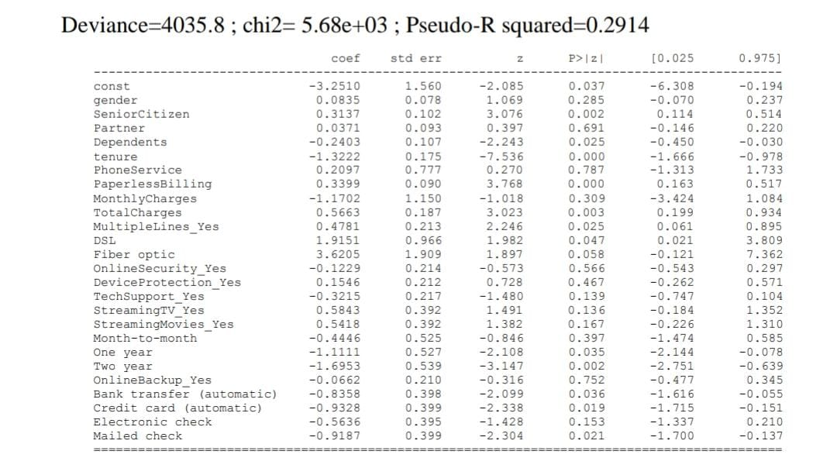
Building Models:
Logit Model-
This is the result of logit model applied and the second column shows the coefficients value.

Slide 15
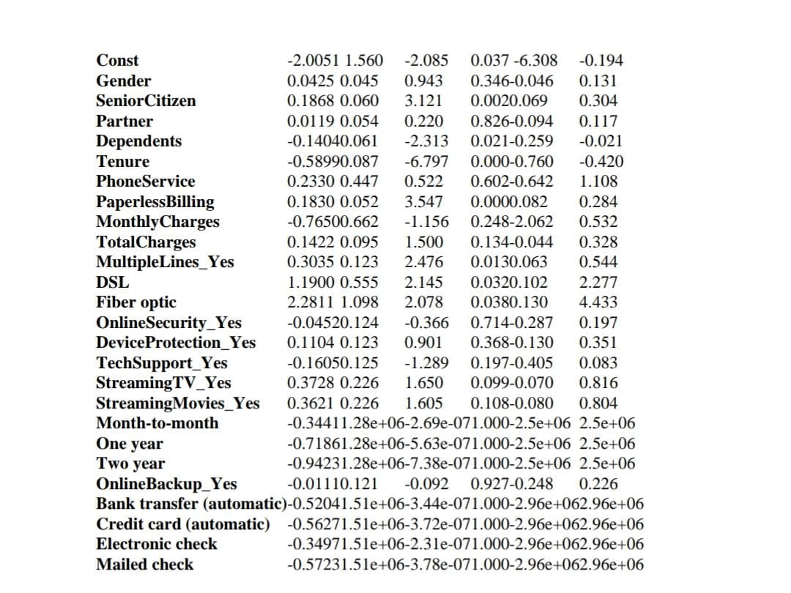
Probit Model- This is the result of probit model applied
coef
std err
z
P>IZI
0.025
0.975
Pseudo-R-squared value=0.2881

Slide 16
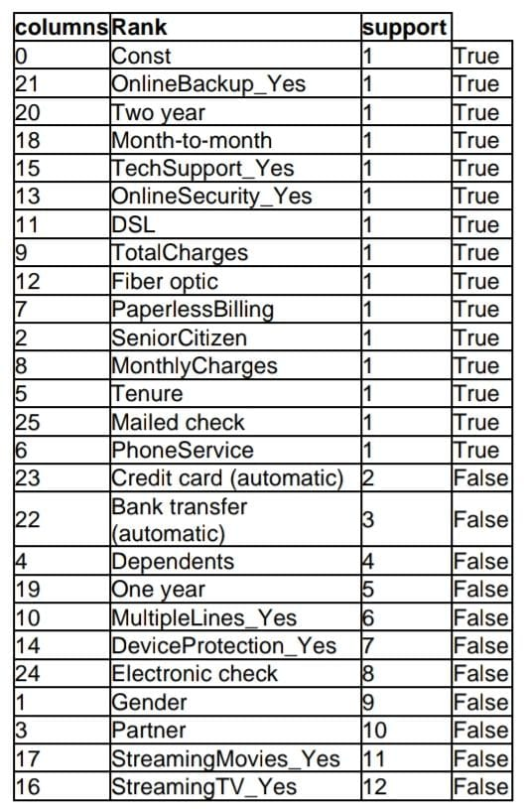
RECURSIVE FEATURE ELIMINATION : We use RFE to eliminate the features that are not useful in analyzing the churning. RFE gives the value ‘TRUE’ to variables that we should keep and ‘FALSE’ to variables that we should drop.

Slide 17
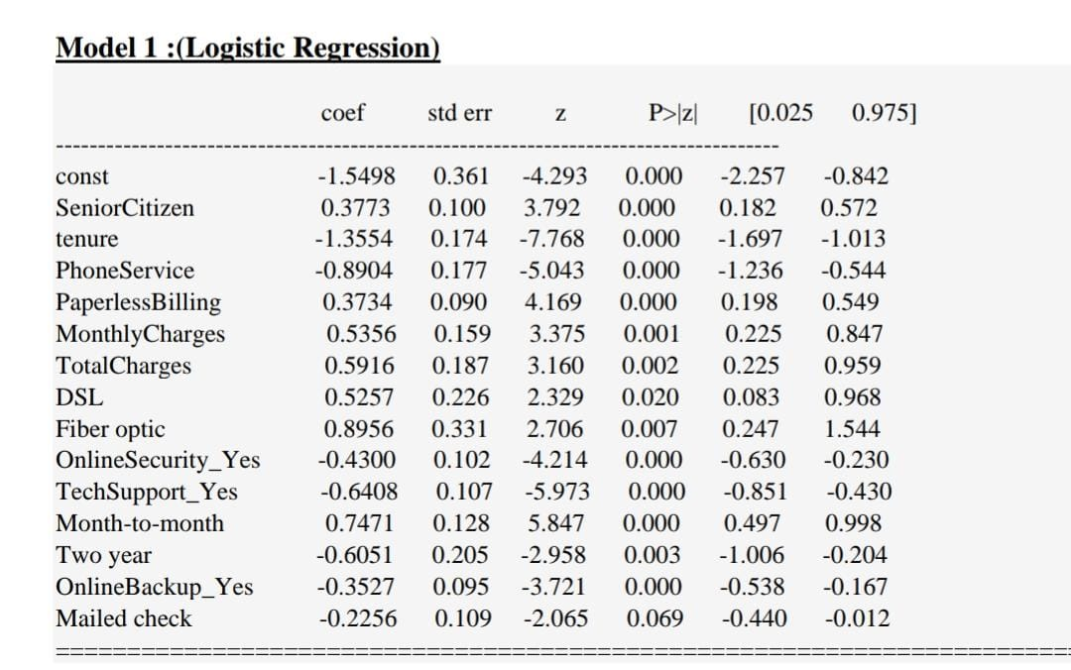
The Pseudo R- Squared value of this model is 0.2866.
Here the p-value of variable “Mailed check” is higher than the significance level so we drop the feature in the next model.

Slide 18
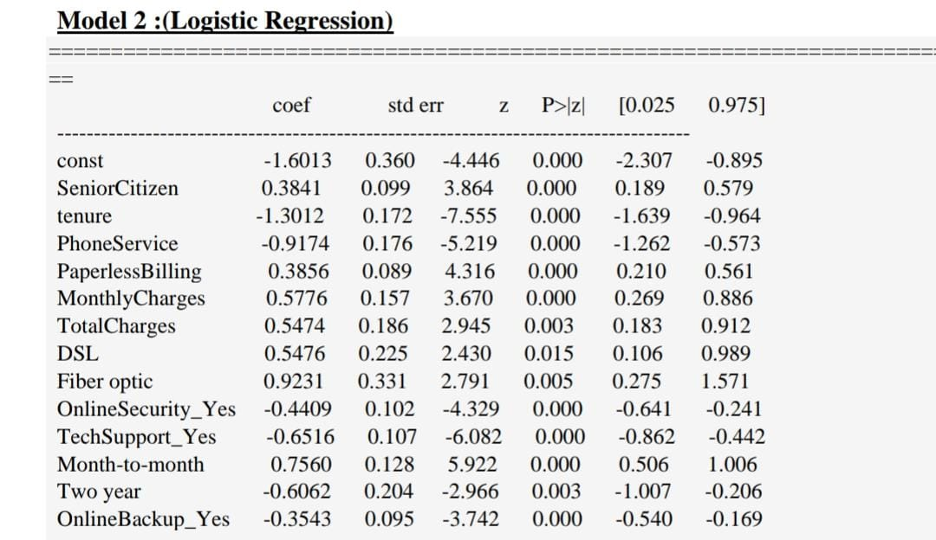
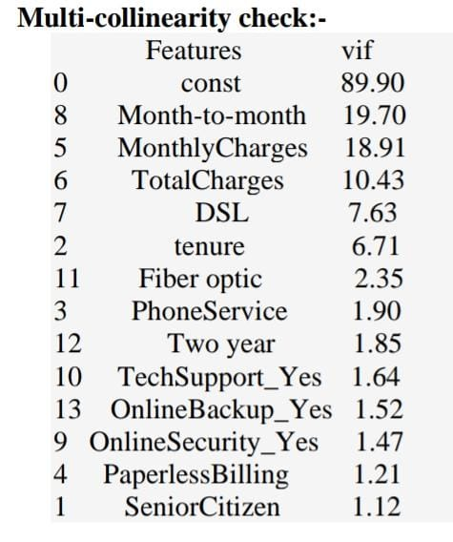
Therefore, we checked VIF of the variables to drop the features one by one.
Dropping attribute “Month-to-month” in the next model as it is highly co-related due to high VIF value(19.70).
All variables are significant as all the features have very small p-value.
The Pseudo R- Squared value of this model is 0.2858.

Slide 19
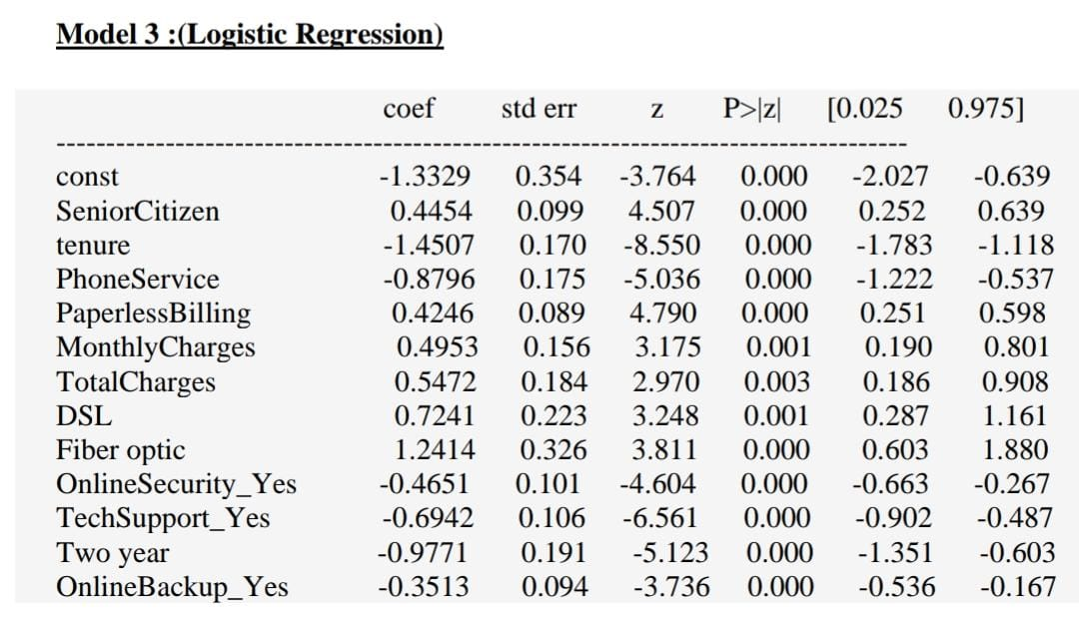
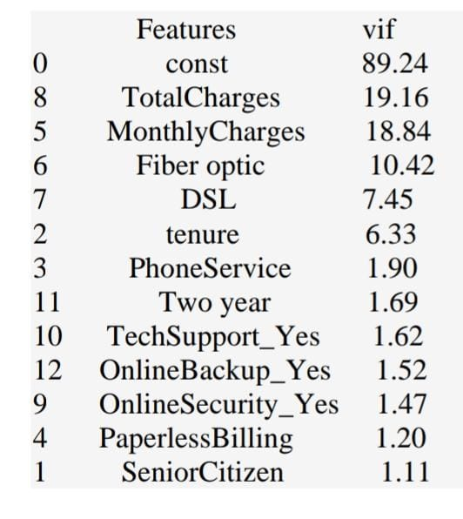
Dropping variable “Total Charges” in the next model as it is highly correlated.
The Pseudo R- Squared value of this model is 0.279.

Slide 20
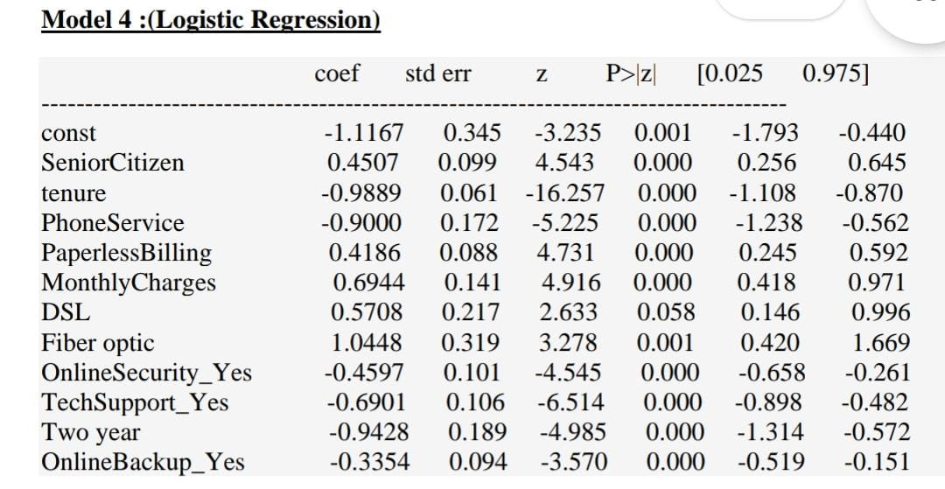
The Pseudo R- Squared value of this model is 0.277.
Dropping variable “DSL” as it is insignificant in the next model as its p-value is greater than 0.05.

Slide 21
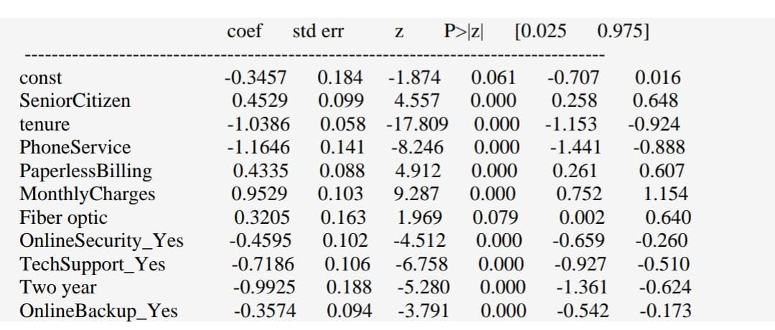
Model 5(Logistic regression)
The Pseudo R- Squared value of this model is 0.2765.
Dropping variable “Fiber optic” as it is insignificant in terms of p-value (greater than 0.05)

Slide 22
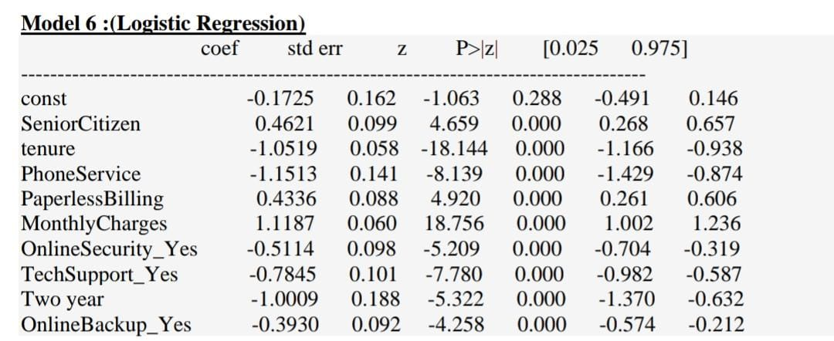
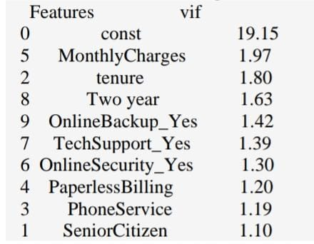
The Pseudo R- Squared value of this model is 0.2758.
McFadden's pseudo R2 ranging from 0.2 to 0.4 indicates very good model fit.
Here all the features are significant
Here all the vif values are less than 5 so this is the final model

Slide 23
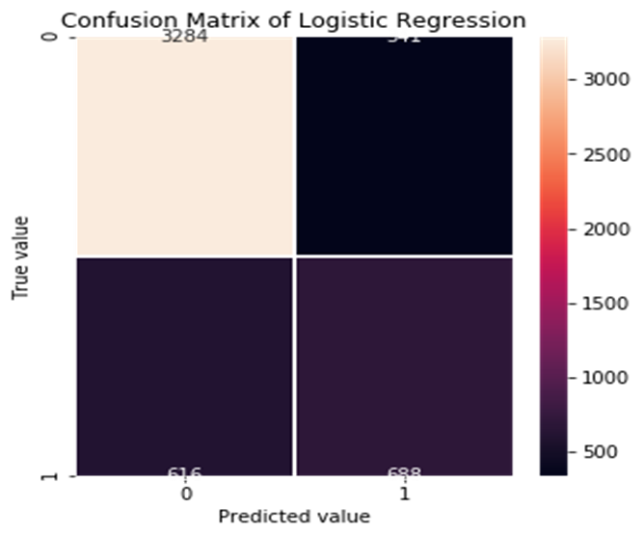
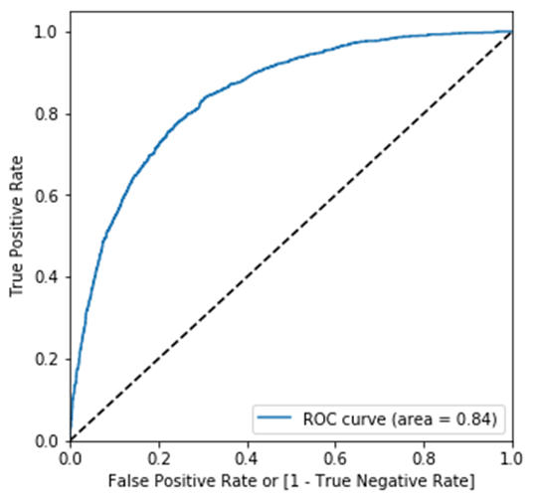
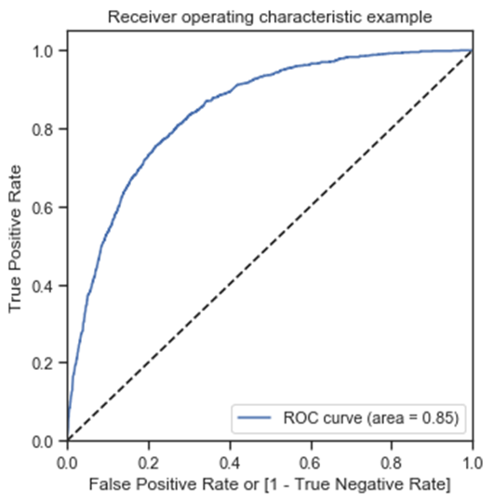
Confusion Matrix and ROC curve of final logistic regression model :
Observations:
Accuracy of the model : 0.8058429701765064
Sensitivity (True Positive Rate) TP / TP + FN : 0.668610301
True negative rate TN / (TN + FP) : 0.842051282
False positive rate FP / (TN + FP) : 0.157948718
False negative rate : 0.331389698
Probit Model
Logit Model

Slide 24

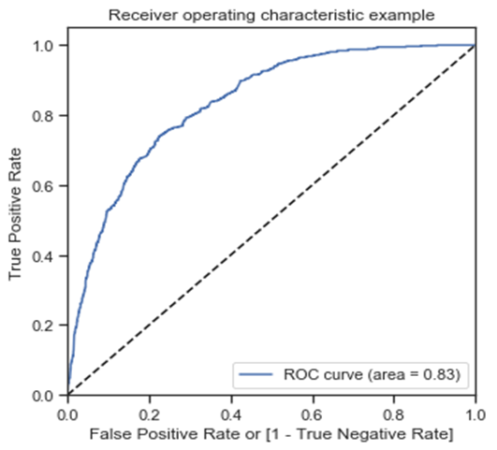
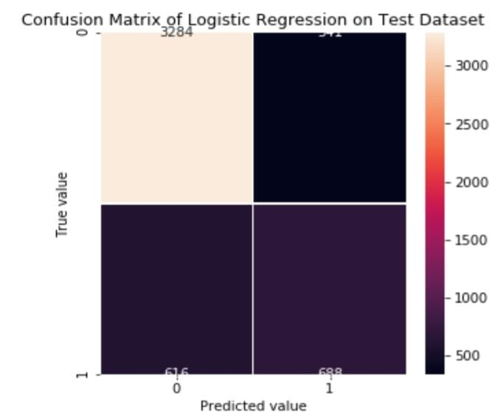
Prediction on test dataset:
Receiver Operating Characteristics Curve traces the percentage of true positives accurately
predicted by a given model as the prediction probability cutoff is lowered from 1 to 0. For a good model, as the cutoff is lowered, it should mark more of actual 1’s as positives and lesser of actual 0’s as 1’s. So for a good model, the curve should rise steeply, indicating that the Y-Axis) increases faster than the X-Axis as the cutoff score decreases. Greater the area under the ROC curve, better the predictive ability of the model.
Test Sensitivity : 0.62806236
Test Specificity : 0.829927884
FPR : 0.170072115
FNR : 0.371937639
precision = 0.63
recall = 0.50
f1-score = 0.56
accuracy = 0.79

Slide 25
Conclusions:
Final Model from Logistic regression:
Probability(Y = churn) = F [ -0.1725+ (0.4621)*Senior Citizen+ (-1.0519)*tenure+ (-1.1513)*Phone Service
+ (0.4336)*Paperless Billing+ (1.1187)*Monthly Charges+ (-0.5114)*Online Security_Yes+ (-0.7845)*Tech Support_Yes+
(-1.0009)*Two Year+ (-0.3930)*Online Backup­_Yes ]
Overall accuracy on test dataset is 79% ,F1 score is 0.56 and AUC of ROC is 0.83 using Logistic Regression.
Since data set is imbalanced, we preferred to use F1 score rather than accuracy.
Gender has no impact on churn.
People having month-to-month contract tend to churn more than people having long term contracts.
As the tenure increases, the probability of churn decreases.
As the monthly charges increases, the probability of churn increases.
Omitted Variable Bias
We have observed in our dataset that there can be some omitted variables –
Income of customer
Age

Slide 26

THANK YOU

